Slide 1
SECURING USER DATA IN CLOUD USING ELLIPTIC CURVE CRYPTOGRAPHY ALGORITHM
GUIDE:
Mr.M.Saravanan, M.E,
PRESENTED BY:
B.Dhinesha -611420104017
M.Mahalakshmi-611420104035
G.Priya - 611420104058
G.Vinodha - 611420104094

Slide 2

CONTEXT
Abstract
Objective
Existing
Disadvantage
Proposed System
Advantage
Module
Conclusion

Slide 3
Abstract
Cloud is an emerging technology utilized by various fields for storage purpose and accessing it from anywhere at any time.
Cloud is Honest but Curious.
So to secure the data encryption and decryption algorithm is used.
User needs to utilize cloud facilities at the same time their data should be protected.
To achieve this Elliptic curve cryptograph (ECC) is used and stored in cloud.

Slide 4
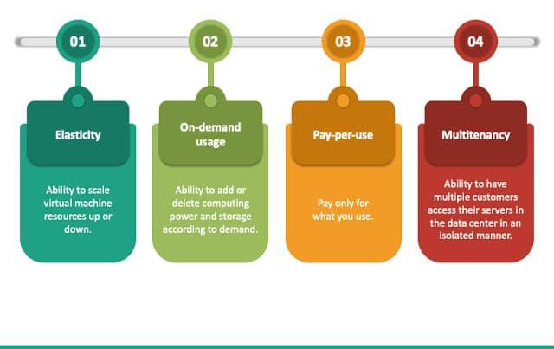
OBJECTIVE
The main objective is to securely store and access data in cloud that is not controlled by the owner of the data.

Slide 5
EXISTING
Electronic medical records, one of the sensitive data, are stored in public or private cloud service providers.
The data are written and updated to the database as AES encrypted.
The signed data transmitted to the user.
The user who has a signature key can decrypt with the private key and the public key.

Slide 6

DISADVANTAGE
Security level is low.
Cloud is semi trusted.
Key generation and maintenance process are difficult

Slide 7
PROPOSED SYSTEM
Cryptographic Systems can be divided into deterministic and probabilistic encryption scheme.
Converts plain text into chipertext
Deterministic encryption –one to one key.
Probabilistic encryption- different keys.

Slide 8

ADVANTAGE
Disaster Recovery
Accessibility
Cost effective
Scalability
Automated backups
Efficient securing of data in cloud.
Key size is minimum

Slide 9
MODULE
Node Registration
File transfer
NODE REGISTRATION
This is module mainly designed to provide the
authority to a user in order to access the other
modules of the project.
Here a user can have the accessibility authority
after the registration

Slide 10

FILE TRANSFER
In this file transfer module mainly designed
to transfer data from user to user.
This module can also be used to find the
misbehavior detection on data transfer
from authorized to user to other user.

Slide 11
CONCLUSION
Elliptic Curve Cryptography(ECC) technique is used to store and access the data files.
It improve the performance during encryption and decryption process.
In this scheme just member of group can access the data stored over shared data section.
The future research inclination in cloud computing models is going on to treat the problem of group sharing of data in the shared data section.

Slide 12
THANK YOU

